Slide 1
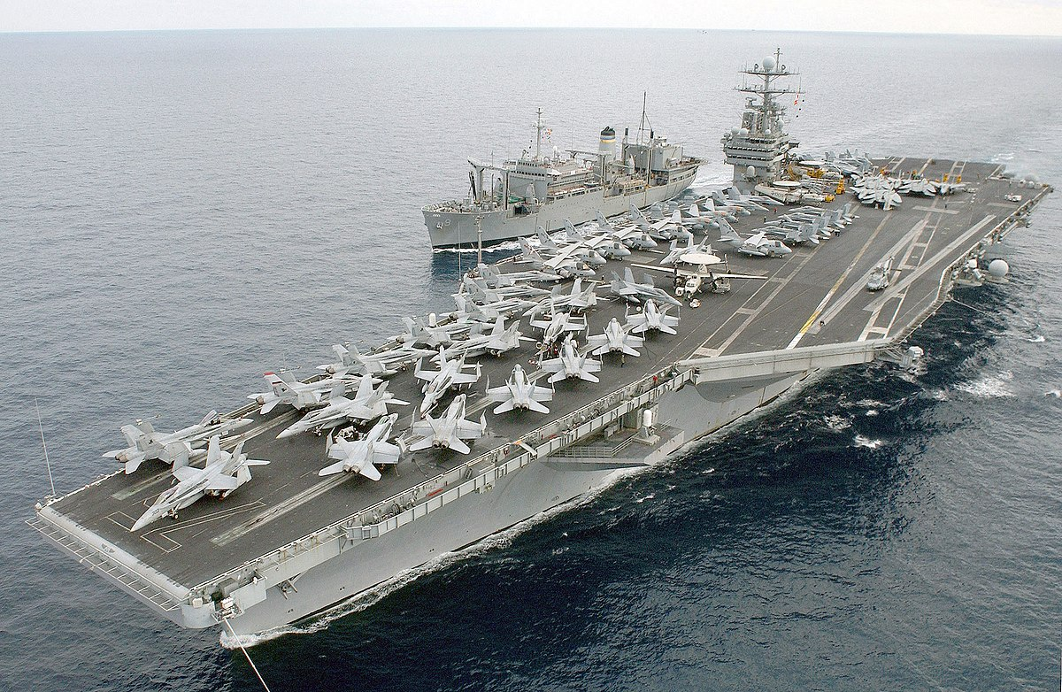
SDR Overview
Presented to:
2024 CAV Symposium
Presented by:
DAVID CHUONG

Slide 2
Agenda
      What is an SDR?
      What is NOT an SDR?
      Platform for submitting an SDR
      Guidelines for Contractors
      Requirements for PDREP Access
      SDR Terminology
      Anatomy of an SDR
      SDR Scenario Walkthrough
      Review of the most common mistakes
      Important Reminders
      NAVSUP WSS SDR POCs

Slide 3
What is an SDR?
Supply Discrepancy Report (SDR) applies to the identification, reporting and resolution of discrepant shipments of material occurring in the Department of Defense (DOD) Logistics System when the shipping (item) and packaging discrepancies are attributable to a shipper (issuer) error.
SDRs are used as a tool to measure the quality of shipper performance and customer support. The ultimate goal is to improve supply chain efficiency and reliability.
      Overage
      Shortage
      Total Non-Receipt
      Incorrect/Misdirected Material
      Incorrect Condition
      Missing/ Incorrect Documentation
      Improper/ Inadequate Packaging

Slide 4

What is NOT an SDR?
      Transportation Discrepancy Report (TDR) occurs when material shipped via any mode of transportation (highway, rail, air, or water) by an approved Transportation Service Provider (TSP) in accordance with Defense Transportation System (DTS) policy and procedure is damaged, lost, or improperly shipped.
      Product Quality Discrepancy Report (PQDR)is used to report material non-conformances, provide a vehicle to recover material cost as a result of the non-conformance, and to take steps to prevent recurrence. Non-conformance deficiencies are any defect, condition, or premature equipment failure indicating deficiencies in design, specification, documentation, material, manufacturing, and workmanship.
      A TDR or PQDR submitted as an SDR will be rejected.

Slide 5
Platform for submitting an SDR
      Product Data Reporting and Evaluation Program (PDREP)
      https://www.pdrep.csd.disa.mil/
      PDREP Customer Support: webptsmh@navy.mil (207) 438-1690
      SECNAV Instruction 4855.3D establishes Product Data Reporting and Evaluation Program (PDREP) as the central Department of the Navy (DON) database to collect, screen, and provide discrepancy contractor/supplier performance data to those activities responsible for purchase, supply, and contract administration.

Slide 6
Guidelines for Contractors
      When a NIIN, condition code, and/or quantity discrepancy exists, the Contractor will complete and submit an SDR to the originator of the shipment within five (5) business days after the discrepant shipment is received, via PDREP.
      When discrepant material is returned to the supply system, the Contractor will include a copy of the SDR (SF-364) with the shipment and return the material under the same document number it was received.
      Contractor will reply to SDRs within thirty (30) days.
      Contractor will inform NAVSUP WSS of current or changed Action Points via email.
      Contractor will provide appropriate DoDAAC and valid email addresses of Action Points to the PDREP Office
      Contractors MUST log into their PDREP account every 30 days to maintain access

Slide 7
Requirements for PDREP Access
      PDREP Access requires a Security Clearance.
      PDREP is a NAVSUP Level II Navy IT System that requires an adjudicated Gov’t Background Investigation (BI) on file to be granted system access.
      NAVSUP WSS Contractor Information Sheet (CIS) and the OF-306 Declaration of Federal Employment are required for the Background Investigation.
      NAVSUP WSS (CIS): CAV Analyst/Sponsor is to pre-fill out the blocks with known information. Of note, the following fields pertain to the Vendor: ‘Prime Vendor’ and ‘Name of Company that Employs You’. Requestor is to complete the remaining blocks at the top and bottom of the WSS CIS form. Form must have ALL blocks filled.
      OF-306: COMPLETE in its entirety. Signature and date is required on 17a. If missing, form will be REJECTED and RETURNED.

Slide 8
Requirements for PDREP Access
      DOD SAFE File Transfer System
      CAV Analyst/Sponsor will send Requestor a File Drop-Off Request from DOD SAFE (Secure Access File Exchange) File Transfer System at https://safe.apps.mil/. A DOD SAFE notification will be sent to the email address provided by the vendor.
      DOD SAFE will protect files and prevent NAVSUP WSS’ Network Firewall from removing the data from your forms due to the possibility of malicious code.
      Requestor is to click on the e-mail link from DOD SAFE sent by the CAV Analyst/Sponsor and upload the WSS CIS and OF-306.
      In order to encrypt the documents, select ‘Encrypt All Files’ and create a passphrase. Requestor must provide CAV Analyst/Sponsor with the passphrase via separate email, so that they can unencrypt the files.
      DOD Safe will notify CAV Analyst/Sponsor by e-mail when the forms are available for download. Upon receipt, they will forward the above documents to NAVSUP WSS Security, by encrypted e-mail to start the background investigation (BI) process if required. If a BI is not present, Security will contact the requestor with further instructions on submitting fingerprints and completing the BI form. If a BI is present, then Security will notify the representative that PDREP access can be approved based on preliminary BI results and can move forward with processing PDREP account request.

Slide 9
Requirements for PDREP Access
      Cyber Awareness Training
      Provide a copy of your Cyber Awareness Training Certificate dated 10/01/2023 or later. Cyber Training Certificates dated prior to 10/01/2023 will NOT be accepted. The certificate must come from the DOD site below. Internal company related Cyber Training certificates will not be accepted by the NAVSUP WSS and NAVSUP BSC ISSM.
      Cyber Awareness Training can be found at: https://public.cyber.mil/. This is a public website, so a DOD CAC is not required. Contractors need to use the DOD Employees Training Link.
      Security Group Mailboxes:
      Philadelphia: usn.philadelphia.navsupwssphil.mbx.philsecurity@us.navy.mil
      Mechanicsburg: usn.mechanicsburg.navsupwssmech.mbx.security@us.navy.mil

Slide 10
SDR Terminology
      SDR Originator: The activity that is reporting a discrepancy, creating the SDR, and submitting the SDR.
      Action Point: The activity responsible for responding to the SDR by utilizing Action Point Response Codes and appending remarks.
      Discrepancy Code: Identifies the problem (W1 - Wrong item received).
      Action Code: Identifies what action is being requested (3B- Discrepancy reported for corrective action and trend analysis. No Reply required)
      Action Point Response Code: The Action Point’s response to the SDR (410 - SDR Closed. Disposition Action Complete).
      Action Point Release Date: Date when Action Point Response Code was added, remarks updated, and Action Point has completed the SDR.

Slide 11
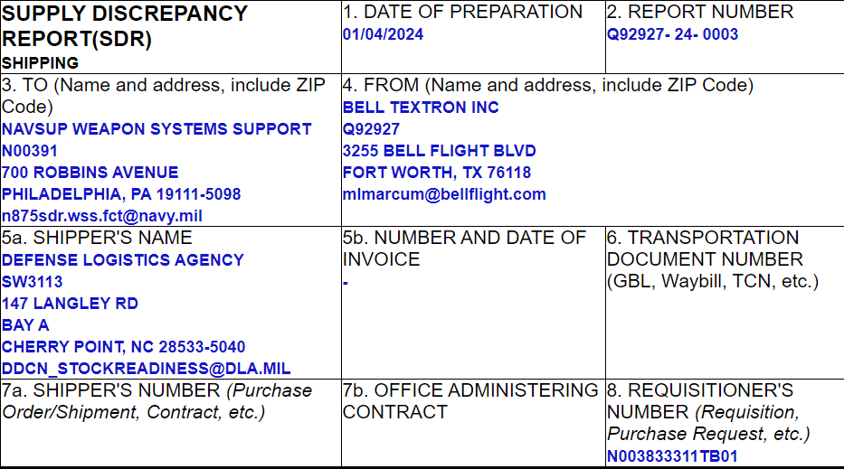
Anatomy of an SDR (SF-364)
Action Point
Originator
Shipper
Document Number

Slide 12
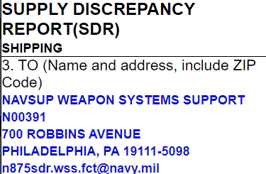
Anatomy of an SDR (SF-364)
An Action Point is the activity responsible for answering your SDR.
Action Point
      When submitting an SDR to NAVSUP WSS N00383, N00391, N00104 select the following Action Point: n875sdr.wss.fct@navy.mil

Slide 13
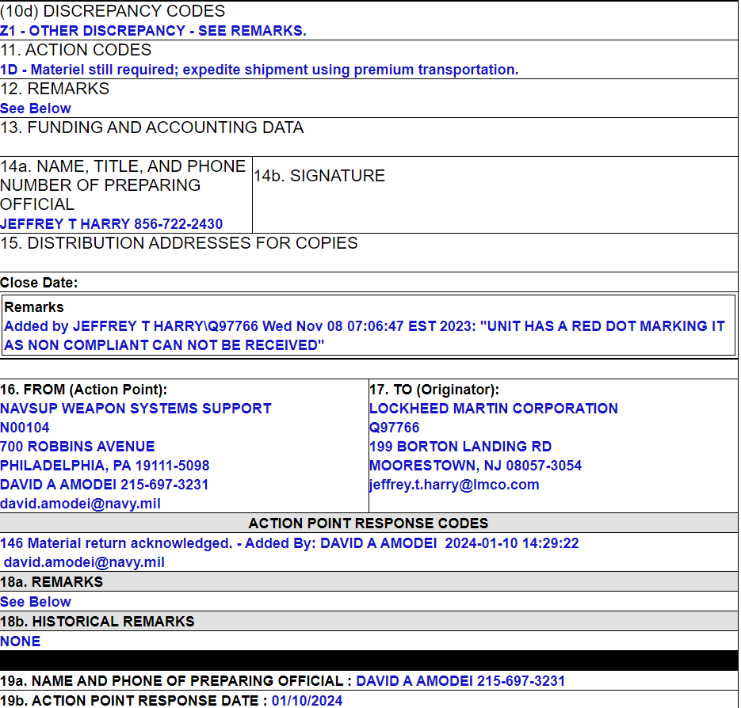
Anatomy of an SDR (SF-364)
If an Action Point Release Date is entered, that SDR is no longer on the Action Point’s work list. If you disagree with the disposition, submit a reconsideration. If you are reopening the SDR for reconsideration make sure to add your reasoning in the Remarks Field
Discrepancy
Action Requested
Remarks
Action Point Response Date

Slide 14
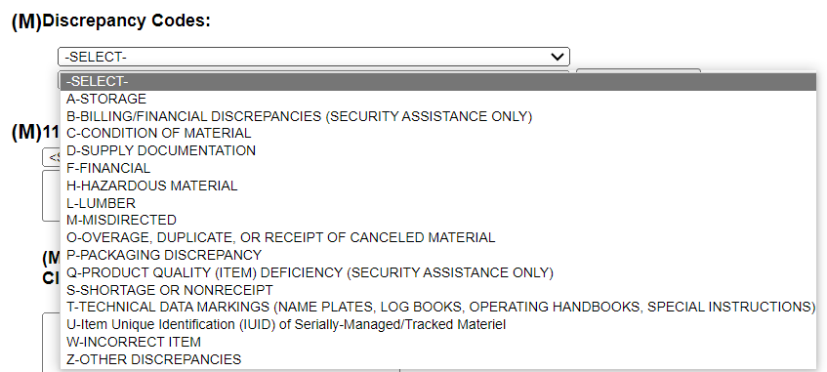
Anatomy of an SDR (SF-364)
Discrepancy Codes

Slide 15
SDR Scenario 1: Missing/ Incorrect Documentation
      If the material received is missing accompanying paperwork, or there is a mismatch regarding the paperwork:
      Contact your CAV Analyst to assist you in obtaining the proper paperwork for your asset
      Do not file an SDR

Slide 16
SDR Scenario 2: Overage of Material Received
      If quantity received is more than quantity on requisition:
      Submit an INFORMATION ONLY SDR to the Action Point (Issuing Activity) using the applicable discrepancy code(s)/action code(s)
      PDREP Discrepancy Code: O (Overage, Duplicate, or Receipt of Cancelled Material)
      Receipt for the extra material received
      If there is an open order and repair capability, induct the material in ‘F’ condition and repair it
      If there is no repair capability, receipt for the overage in ‘J’ Condition and ship the excess material to the nearest ATAC

Slide 17
SDR Scenario 3: Shortage of Material
      If quantity received is less than quantity on requisition (1348):
      Submit the SDR to the Issuing Activity as an Action Point
      PDREP Discrepancy Code: S (Shortage or Non-Receipt)
      The Issuing Activity (Action Point) will either ship you the missing asset(s) or provide a tracking number and Proof of Delivery (POD) to your site
      If the provided tracking shows the carrier lost asset, file a TDR
      If the Action Point has a Proof of Delivery (POD) for the correct quantity the contractor must submit an LDD. Before LDD submission, ensure material was not erroneously received under a different document number (fleet document number)

Slide 18
SDR Scenario 4: Total Non-Receipt
      If shipment is not received:
      Submit the SDR to the Issuing Activity as an Action Point
      PDREP Discrepancy Code: S (Shortage or Non-Receipt)
      The Issuing Activity (Action Point) will either verify asset(s) did not ship, ship you the missing asset(s) or provide a tracking number and Proof of Delivery (POD) to your site.
      If the provided tracking shows the carrier lost asset, file a TDR
      If the Action Point has a Proof of Delivery (POD) to your site an LDD must be submitted. Note research should be done to ensure the material was not erroneously received under a different document number (fleet document number)

Slide 19
SDR Scenario 5: Incorrect Item Received/ Misdirected
      If you receive an incorrect or misdirected item:
      Submit an Information Only SDR for incorrect item received
      PDREP Discrepancy Code: W (Incorrect Item)
      If you have the ability to repair the incorrect item received (on contract), receipt for the material in ‘F’ Condition, induct, and repair
      If you do not have the repair capability, receipt for what you actually received in ‘J’ Condition and ship it to the nearest ATAC under the same document number.
      If the item cannot be identified, take pictures of the material and upload them onto PDREP. Receipt for the asset under NIIN MDJ111111 in ‘J’ Condition and ship it to the nearest ATAC under the same document number.

Slide 20
SDR Scenario 6: Packaging Discrepancy
      If you receive an asset that is improperly packaged:
      Submit an information only SDR describing the improper packaging and damage
      PDREP Discrepancy Code: P (Packaging Discrepancy)
      If you have the ability to repair the improperly packaged item received (on contract), receipt for the material in ‘F’ Condition, induct, and repair
      If you do not have repair capability, receipt for what you actually received in ‘F’ Condition and contact your CAV Analyst so the item manager can be notified, and disposition can be provided.

Slide 21
Most Common Mistakes
Problems
Not choosing the right Action Point
I don’t know who my government sponsor is for PDREP
My Application for PDREP has been rejected due to security reasons
Solutions
Send SDR to the Issuing Activity unless it is for incorrect material received. If the material is incorrect ALWAYS submit the SDR to NAVSUP WSS. Return the material to the nearest ATAC.
Your government sponsor is ALWAYS your CAV analyst
You must apply for security clearance BEFORE applying for PDREP access

Slide 22
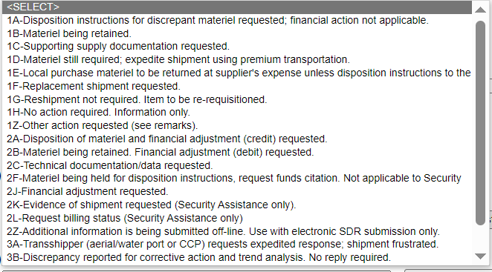
Most Common Mistakes (cont.)
Do not choose Action Codes 1G, 1H, 3B.
DISPOSTION WILL NOT BE PROVIDED
Only submit an Information Only SDR for an Overage of material

Slide 23
Important Reminders
      REMEMBER TO LOG INTO PDREP EVERY 30 DAYS OR YOUR ACCESS WILL BE REVOKED
      SDRs DO NOT CLOSE SIT. Contact your CAV Analyst regarding open SIT
      PER CAV SOW, SDRs MUST be submitted within 5 business days from when the material was received
      PER CAV SOW, SDRs MUST be answered by contractor within 30 days from when the SDR was created
      Security Clearance must be approved BEFORE applying for PDREP Access
      The CAV Analyst is the government sponsor for Contractor access to PDREP

Slide 24
NAVSUP WSS SDR POCs
Philadelphia
Matthew Cann (3B and 9 COG Material): SDR_N413.WSS.FCT@NAVY.MIL
Theresa Tyler (Packaging): PHSTSDR.PHIL.WSS.FCT@NAVY.MIL
Jill Tiernan (Suspended J,K,L): NAVSUP_SUSPENDED.FCT@NAVY.MIL
Mechanicsburg
Vickie Edgar (Suspended J,K,L): COSIS.FCT@NAVY.MIL
Bethany Smith (Packaging): N975SDR.wss.fct@navy.mil
Remaining SDRs not listed for Mechanicsburg and Philadelphia
David Amodei: N875SDR.WSS.FCT@NAVY.MIL
David Chuong (TL): david.chuong.civ@us.navy.mil
Rita Dolan (Supervisor): rita.p.dolan.civ@us.navy.mil

Slide 25

Questions?
Notes:
An SH-60B Sea Hawk helicopter assigned to the Dragonslayers of Helicopter Anti-Submarine Squadron (HS) 11 performs a vertical replenishment between the aircraft carrier USS Enterprise (CVN 65) and the Military Sealift Command fast combat support ship USNS Supply (T-AOE 6).

Slide 26
Websites and Sources
PDREP
https://pdrep.csd.disa.mil
SDR References
SECNAV Instruction 4855.3D
DLMS 4000.25 Vol 2, Ch 17
TDR Policy & Guidance
usarmy.scott.sddc.mbx.hq-loss-damage-reporting@army.mil
CAV Statement of Work
https://www.navsup.navy.mil/public/navsup/wss/pi_cd/

